Slide 1


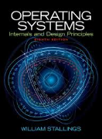
Welcome to
CS 345 Operating Systems
Chapter 3 - Processes (07)

Slide 2
Tip #7: The Rule of Seven
In grouping situations, control is often optimized around the seven mark.
from the grouping of leaves on plants,
to the number of layers in the OSI network model,
to the number of layers of management in the Catholic church,
to the number of chunks of information that the short-term memory can comfortably handle.
A simple application of the rule of seven in programming is where there might be seven chunks of code in a function, each containing seven statements, thus giving a reasonable function size is around 49 lines.
The actual grouping count is rather inexact and an extension to this rule is 'seven, plus or minus two'.
When a function length gets to ten, it is broken into two independent groups of five, each of which now fits back in the five to nine range.
Applying this rule of seven extension to the reasonable function size gives a function size range of between 25 and 100 lines.

Slide 3
P1 Pass-off
Use P1& to test background tasks:
int P1_project1(int argc, char* argv[])
{
int p1_mode = 0;
if (argc > 1) p1_mode = atoi(argv[1]);
switch(p1_mode)
{
default:
case 0:
int j;
for (j = 0; j < 4; j++)
{
int i;
printf("\nI'm Alive %d,%d", curTask, j);
for (i = 0; i < 100000; i++) swapTask();
}
break;
case 1:
// create 3 tasks
break;
}
return 0;
} // end P1_project1
myOS345
c:\lcc\projects\pros345.exe
New Task[0] myShell
0>>lt
0/0 myShell 5 Running
3>>p1
I'm Alive 0,0lt
I'm Alive 0,1
I'm Alive 0,2
I'm Alive 0,3
400005>>
0/0 myShell 5 Running
400008>>p1&
400011>>
New Task[1] p1
I'm Alive 1,0lt
0/0 myShell 5 Running
1/0 p1 5 Ready
486881>>
I'm Alive 1,1
I'm Alive 1,2
I'm Alive 1,3
Task[1] returned 0
Use P3 to test ^x, ^w, and ^r signals.

Slide 4
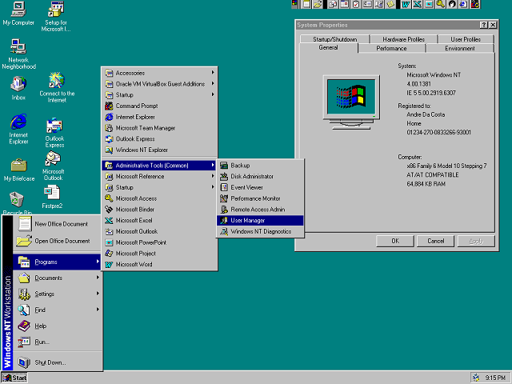
The OS Evolution
OS Complexity
BINAC
IBM System/360 Model 67
ENIAC
UNIVAC
IBM 701
UNIVAC 1103A
FORTRAN
IBM 7090
Burroughs B5000
DEC PDP-1
IBM System/360
GE-645 Mainframe
DEC PD-8
Intel 4004
Ethernet, WYSIWYG, Mouse
Altair 8800
CRAY-1
BASIC, CP/M
Apple II, PET, Atari
DEC VAX 11/780
Visicalc, WordStar
IBM PC
Apple Macintosh
SUN NFS
MACH vs Amoeba
Windows 3.0
GNU / Linux
EDSAC and EDVAC
Windows NT
Transistor
1940
1950
1960
1970
1980
1990
2000
2010
2020
Notes:
Jace Kandare

Slide 5
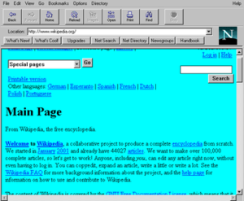
The OS Evolution
OS Complexity
BINAC
IBM System/360 Model 67
ENIAC
UNIVAC
IBM 701
UNIVAC 1103A
FORTRAN
IBM 7090
Burroughs B5000
DEC PDP-1
IBM System/360
GE-645 Mainframe
DEC PD-8
Intel 4004
Ethernet, WYSIWYG, Mouse
Altair 8800
CRAY-1
BASIC, CP/M
Apple II, PET, Atari
DEC VAX 11/780
Visicalc, WordStar
IBM PC
Apple Macintosh
SUN NFS
MACH vs Amoeba
Windows 3.0
GNU / Linux
Windows NT
EDSAC and EDVAC
Mosaic, Netscape, IE
Transistor
1940
1950
1960
1970
1980
1990
2000
2010
2020
Notes:
Nathan Fastabend

Slide 6

The OS Evolution
OS Complexity
BINAC
IBM System/360 Model 67
ENIAC
UNIVAC
IBM 701
UNIVAC 1103A
FORTRAN
IBM 7090
Burroughs B5000
DEC PDP-1
IBM System/360
GE-645 Mainframe
DEC PD-8
Intel 4004
Ethernet, WYSIWYG, Mouse
Altair 8800
CRAY-1
BASIC, CP/M
Apple II, PET, Atari
DEC VAX 11/780
Visicalc, WordStar
IBM PC
Apple Macintosh
SUN NFS
MACH vs Amoeba
Windows 3.0
GNU / Linux
Windows NT
Mosaic, Netscape, IE
EDSAC and EDVAC
ios
Transistor
1940
1950
1960
1970
1980
1990
2000
2010
2020
Notes:
Jungjin Cho

Slide 7
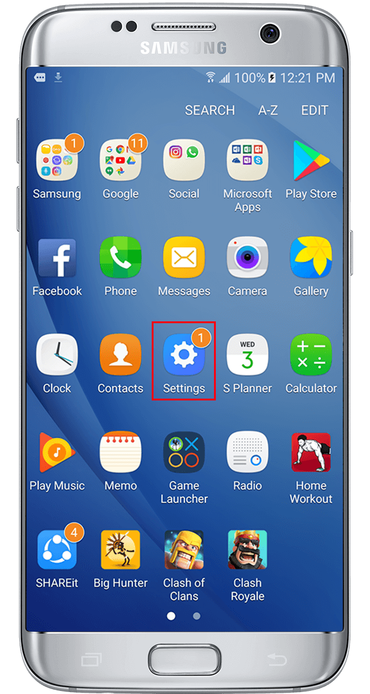
The OS Evolution
OS Complexity
BINAC
IBM System/360 Model 67
ENIAC
UNIVAC
IBM 701
UNIVAC 1103A
FORTRAN
IBM 7090
Burroughs B5000
DEC PDP-1
IBM System/360
GE-645 Mainframe
DEC PD-8
Intel 4004
Ethernet, WYSIWYG, Mouse
Altair 8800
CRAY-1
BASIC, CP/M
Apple II, PET, Atari
DEC VAX 11/780
Visicalc, WordStar
IBM PC
Apple Macintosh
SUN NFS
MACH vs Amoeba
Windows 3.0
GNU / Linux
Windows NT
Mosaic, Netscape, IE
ios
EDSAC and EDVAC
Android OS
Transistor
1940
1950
1960
1970
1980
1990
2000
2010
2020
Notes:
Jeremy Payne

Slide 8

The OS Evolution
OS Complexity
BINAC
IBM System/360 Model 67
ENIAC
UNIVAC
IBM 701
UNIVAC 1103A
FORTRAN
IBM 7090
Burroughs B5000
DEC PDP-1
IBM System/360
GE-645 Mainframe
DEC PD-8
Intel 4004
Ethernet, WYSIWYG, Mouse
Altair 8800
CRAY-1
BASIC, CP/M
Apple II, PET, Atari
DEC VAX 11/780
Visicalc, WordStar
IBM PC
Apple Macintosh
SUN NFS
MACH vs Amoeba
Windows 3.0
GNU / Linux
Windows NT
Mosaic, Netscape, IE
ios
Android OS
EDSAC and EDVAC
Google Chrome
Transistor
1940
1950
1960
1970
1980
1990
2000
2010
2020
Notes:
Sam Meng

Slide 9

The OS Evolution
OS Complexity
BINAC
IBM System/360 Model 67
ENIAC
UNIVAC
IBM 701
UNIVAC 1103A
FORTRAN
IBM 7090
Burroughs B5000
DEC PDP-1
IBM System/360
GE-645 Mainframe
DEC PD-8
Intel 4004
Ethernet, WYSIWYG, Mouse
Altair 8800
CRAY-1
BASIC, CP/M
Apple II, PET, Atari
DEC VAX 11/780
Visicalc, WordStar
IBM PC
Apple Macintosh
SUN NFS
MACH vs Amoeba
Windows 3.0
GNU / Linux
Windows NT
Mosaic, Netscape, IE
ios
Android OS
Google Chrome
EDSAC and EDVAC
Internet of Things
Transistor
1940
1950
1960
1970
1980
1990
2000
2010
2020
Notes:
Nicole Curtis

Slide 10

The OS Evolution
OS Complexity
BINAC
IBM System/360 Model 67
ENIAC
UNIVAC
IBM 701
UNIVAC 1103A
FORTRAN
IBM 7090
Burroughs B5000
DEC PDP-1
IBM System/360
GE-645 Mainframe
DEC PD-8
Intel 4004
Ethernet, WYSIWYG, Mouse
Altair 8800
CRAY-1
BASIC, CP/M
Apple II, PET, Atari
DEC VAX 11/780
Visicalc, WordStar
IBM PC
Apple Macintosh
SUN NFS
MACH vs Amoeba
Windows 3.0
GNU / Linux
Windows NT
Mosaic, Netscape, IE
ios
Android OS
Google Chrome
Internet of Things
EDSAC and EDVAC
Wearables, Smart Watches, Smart Glasses, VR gear
Transistor
1940
1950
1960
1970
1980
1990
2000
2010
2020
Notes:
Jared Householder

Slide 11
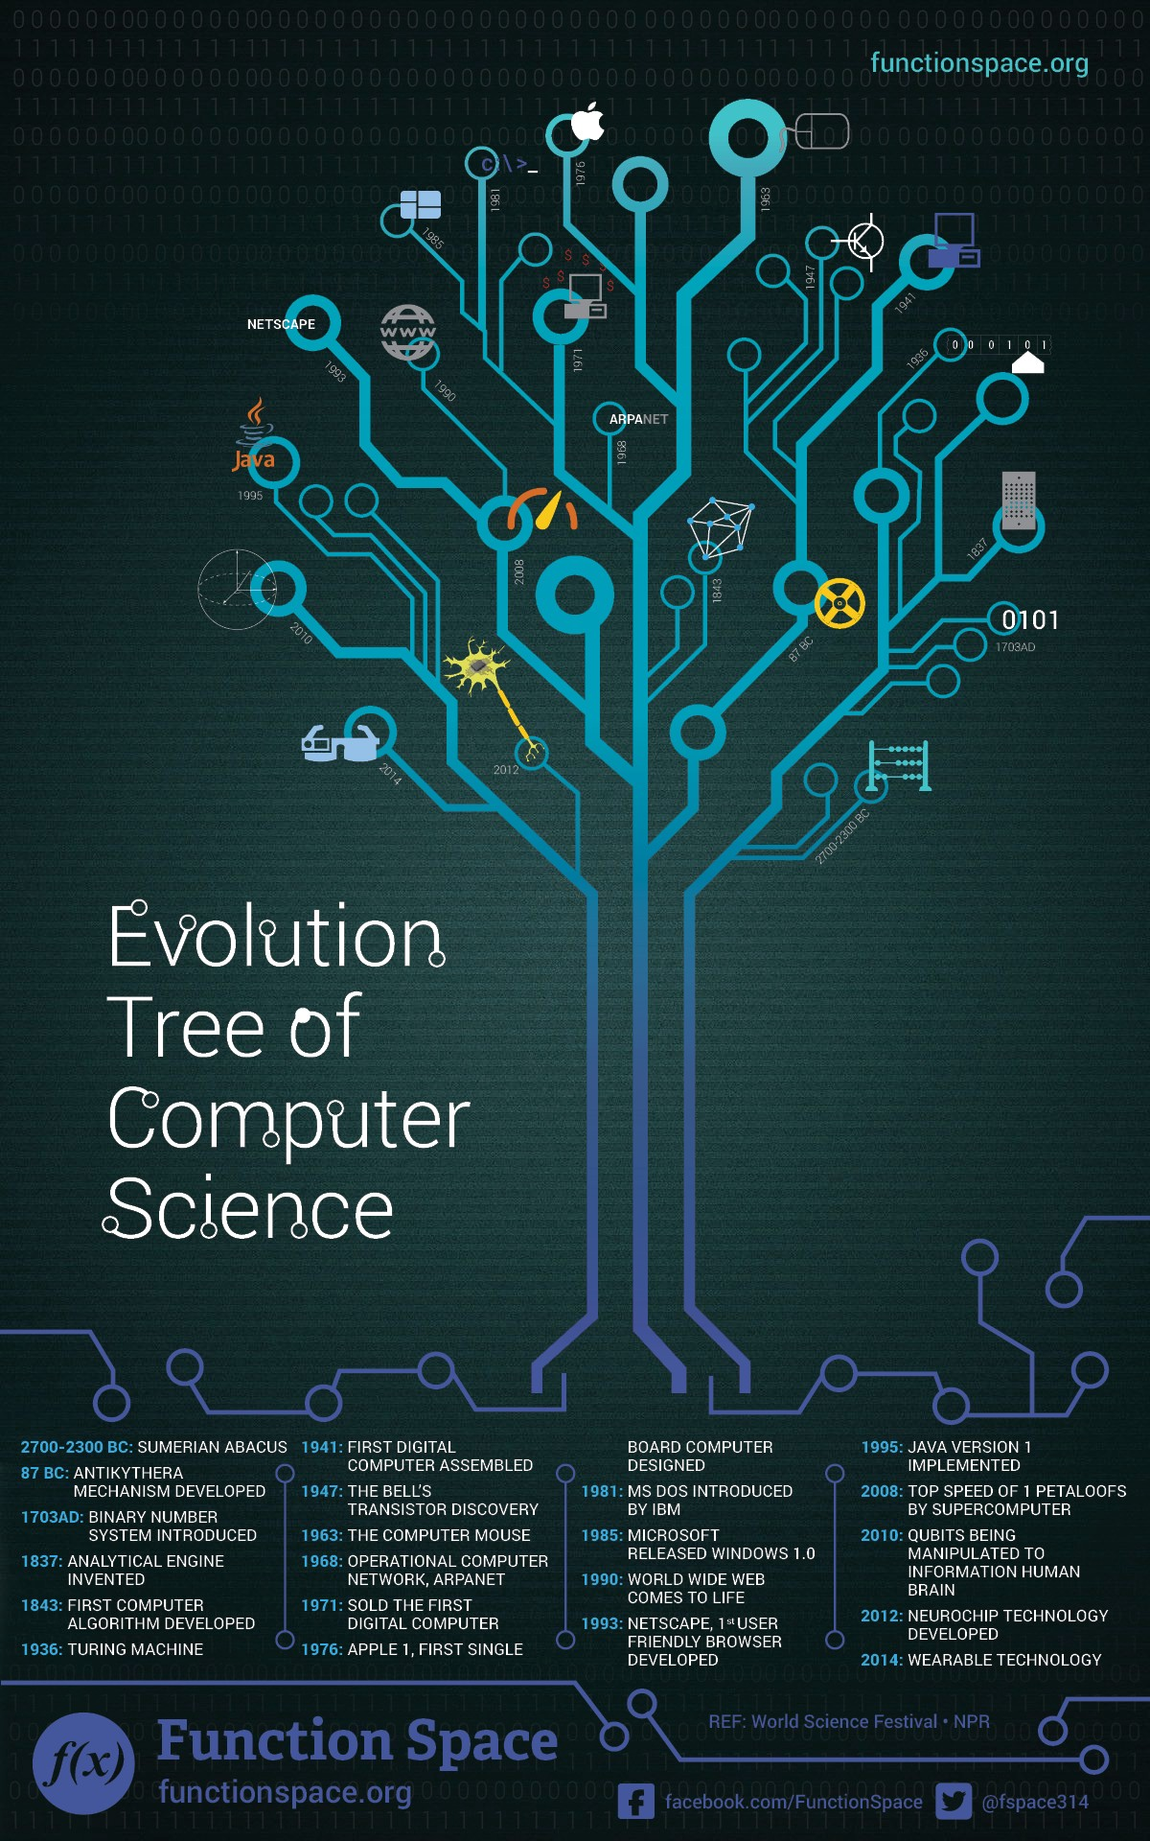
Evolution of Operating Systems
Early Systems (1950)
Simple Batch Systems (1960)
Multi-programmed Batch Systems (1970)
Time-Sharing and Real-Time Systems (1970)
Personal/Desktop Computers (1980)
Multiprocessor Systems (1980)
Networked/Distributed Systems (1980)
Web-based Systems (1990)
Virtualization …
1st generation 1945 – 1955
- vacuum tubes, plug boards
2nd generation 1955 – 1965
- transistors, batch systems
3rd generation 1965 – 1980
- ICs and multiprogramming
4th generation 1980 – 2000
- personal computers
5th generation – 2000 – ????
- ubiquitousness, mobile

Slide 12

Why is Linux so complicated?
First of all, Linux is not more complicated than Windows 10 or MacOS. The complexity is, however, not concealed very well.
Linux is not the design of a single person or a small team with a vision.
It is the product of a glorious scrum of competing visions and individual contributors.
As such, the various pieces and parts, designed to different aesthetics, tend to clash a bit where they meet. Those differences often show through.
Worse, maintenance isn’t as fun as new coding, so people change things that were working just fine, and half the community adopts the new different thing, even though it just does the same stuff in a new way but with added complexity.
Nothing gets thrown away
For example, there is no single email program everyone uses. Every mail program ever written for Unix or Linux is still around and likely available to you with a single download. Linux sometimes looks complicated because there are forty eleven ways to do anything you might want to do.
This also can make it difficult to look for solutions on the internet, because there will be a hundred solutions out there, each of which will work in some slightly different context.

Slide 13
Why is Linux so complicated?
There is no boundary
With Windows or MacOS, it is what comes in the box. No one confuses Microsoft Office as being part of Windows, or Corel Draw or whatever. In contrast, there are many many thousands of applications which run on Linux, which can be installed with the click of a package manager, or even included willy nilly with a distribution. No one has any idea what is Linux and what is some third party app. Should Linux get the blame for some incoherent graphics editor?
So yes. It can be as complicated as you like. If you like “works with no fuss as long as you don’t change anything” then distributions like Ubuntu aren’t bad. Such things are a curated packaging from the bazaar of Linux, that have in fact undergone some testing for obvious failings and will probably work as long as you stay on the paths.
I’ll add that you shouldn’t confuse complicated with flakey. Linux, by and large, is not at all flakey. Systems I use regularly stay up with no fuss for six months or a year or until a power failure occurs. (I find MacOS just about as good at reliability, and I am not really a Windows user.)

Slide 14
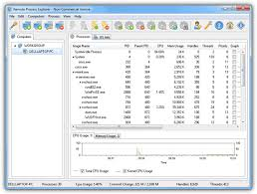
Chapter 3 – Processes Part 1

Slide 15
CS 345
Stalling’s Chapter | # | Project
1: Computer System Overview 2: Operating System Overview | 4 | P1: Shell
3: Process Description and Control 4: Threads | 4 | P2: Tasking
5: Concurrency: ME and Synchronization 6: Concurrency: Deadlock and Starvation | 6 | P3: Jurassic Park
7: Memory Management 8: Virtual memory | 6 | P4: Virtual Memory
9: Uniprocessor Scheduling 10: Multiprocessor and Real-Time Scheduling | 6 | P5: Scheduling
11: I/O Management and Disk Scheduling 12: File Management | 8 | P6: FAT
Student Presentations | 6

Slide 16
Chapter 3 Process Description and Control
The concept of process is fundamental to the structure of modern computer operating systems. Its evolution in analyzing problems of synchronization, deadlock, and scheduling in operating systems has been a major intellectual contribution of computer science.
Research Study, MIT Press, 1980

Slide 17
Chapter 3 Learning Objectives
Define the term process and explain the relationship between processes and process control blocks.
Explain the concept of a process state and discuss the state transitions the processes undergo.
List and describe the purpose of the data structures and data structure elements used by an OS to manage processes.
Assess the requirements for process control by the OS.
Understand the issues involved in the execution of OS code.
Assess the key security issues that relate to operation systems.
Describe the process management scheme for UNIX SVR4.

Slide 18













New Building Construction
Identify
Computer
Data
Context
Programs
Interrupts
Builder (General Contractor)
Operating System
Materials
Scheduling
2 State
5 state
Workers
Consumeable
Resources
States
New
Working
Waiting
Blocked
Suspended
Completed
New Building
Task or Process
Tools
Threads
Reusable
Libraries
What needs to be Managed?

Slide 19
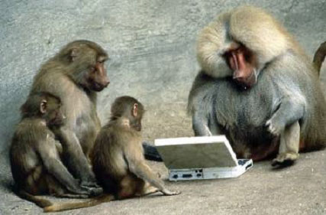

Be Safe

